Slide 1
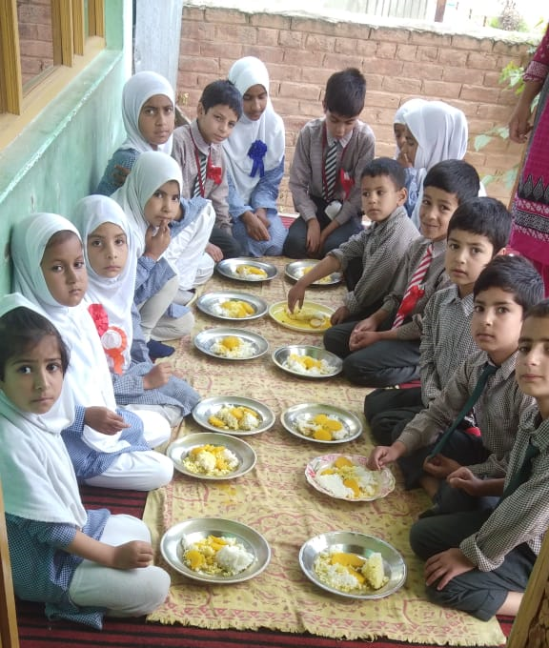
PAB - MDM Meeting for Review of Implementation of MDMS in Jammu & Kashmir -- 12.06.2019
Mid Day Meal Scheme
Ministry of HRD, Govt. of India

Slide 2
No. of Schools (Primary & U. Primary)
Name of States | PAB Approval | Coverage | %age
Jammu & Kashmir | 23130 | 23121 | 100%
Ministry of HRD, Govt. of India

Slide 3
Coverage of children (Primary & U. Primary)
State | Children (Pry) |  |  | Children (U. Pry)
 | PAB Approval | Coverage | %age | PAB Approval | Coverage | %age
Jammu & Kashmir | 518694 | 405348 | 78% | 258304 | 203320 | 79%
Ministry of HRD, Govt. of India

Slide 4
Working Days (Primary & U. Primary)
State | Working Days (Pry) |  |  | Working Days (U. Pry)
 | PAB Approval | Coverage | %age | PAB Approval | Coverage | %age
Jammu & Kashmir | 220 | 183 | 83% | 220 | 183 | 83%
Ministry of HRD, Govt. of India

Slide 5
Construction of Kitchen-cum-stores (KS) (Primary & U. Primary)
State | PAB Approval | Constructed | %age
Jammu & Kashmir | 11815 | 7118 | 60%
Ministry of HRD, Govt. of India

Slide 6
Procurement of Kitchen devices (Primary & U. Primary)
State | PAB Approval | Procured | %age
Jammu & Kashmir | 22843 | 21532 | 94%
Ministry of HRD, Govt. of India

Slide 7
Engagement of Cook-cum-helpers (Primary & U. Primary)
State | PAB Approval | Engaged | %age
Jammu & Kashmir | 33268 | 31136 | 94%
Ministry of HRD, Govt. of India

Slide 8
Performance Grade Index (PGI)
Performance Grading Index (PGI):
Score against the weightage of 10 for indicator No. 1.3.7 i.e. “% of elementary school’s children taking MDM against target approved in PAB – in Govt. and aided schools”.
Score against the weightage of 10 for indicator No 1.3.8 i.e. “% of days Mid Day Meal served against total working days – Govt. and aided elementary schools.”
State | Score (children taking MDM) (1.3.7) out of 10 | Score (MDM served days ) (1.3.8) out of 10
Jammu & Kashmir | 8 | 9
Ministry of HRD, Govt. of India

Slide 9
Performance Score Card – Jammu & Kashmir
Component | PAB Approval / Allocation | Utilization | % Utilization
Institutions | 23130 | 23121 | 100%
Children | 776998 | 608668 | 78%
Working Days | 220 | 183 | 83%
Food Grain (MTs) | 19935 | 12999 | 65%
Cooking Cost (Rs. in lakhs) | 8225 | 5411 | 66%
Cook cum Helpers Engaged | 33268 | 31136 | 94%
Honorarium to Cook Cum Helpers (Rs. in lakhs) | 3327 | 3048 | 92%
TA (Rs. in lakh) | 269 | 202 | 73%
MME (Rs. in lakh) | 203 | 153 | 75%
Kitchen cum Stores | 11815 | 7118 | 60%
Kitchen Devices | 22843 | 21532 | 94%
No. of Children Health Check-up | 941554 | 756336 | 80%
Annual Data Entry | 23121 | 20196 | 87%
Monthly Data Entry | 23121 | 15521 | 67%
Ministry of HRD, Govt. of India

Slide 10
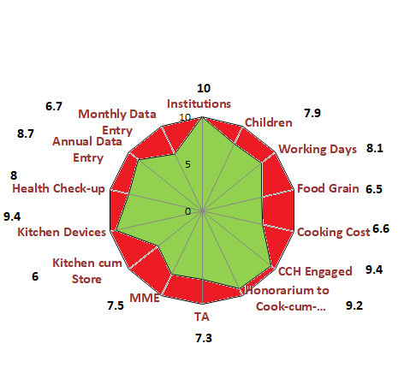
Performance Score Card – Jammu & Kashmir
Component | PAB Approval / Allocation | Utilization | % Utilization
Institutions | 23130 | 23121 | 100%
Children | 776998 | 614340 | 79%
Working Days | 220 | 179 | 81%
Food Grain (MTs) | 19935 | 12999 | 65%
Cooking Cost (Rs. in lakhs) | 8225 | 5411 | 66%
Cook cum Helpers Engaged | 33268 | 31136 | 94%
Honorarium to Cook Cum Helpers (Rs. in lakhs) | 3327 | 3048 | 92%
TA (Rs. in lakh) | 269 | 202 | 73%
MME (Rs. in lakh) | 203 | 153 | 75%
Kitchen cum Stores | 11815 | 7118 | 60%
Kitchen Devices | 22843 | 21532 | 94%
No. of Children Health Check-up | 941554 | 756336 | 80%
Annual Data Entry | 23121 | 20196 | 87%
Monthly Data Entry | 23121 | 15521 | 67%
Ministry of HRD, Govt. of India

Slide 11
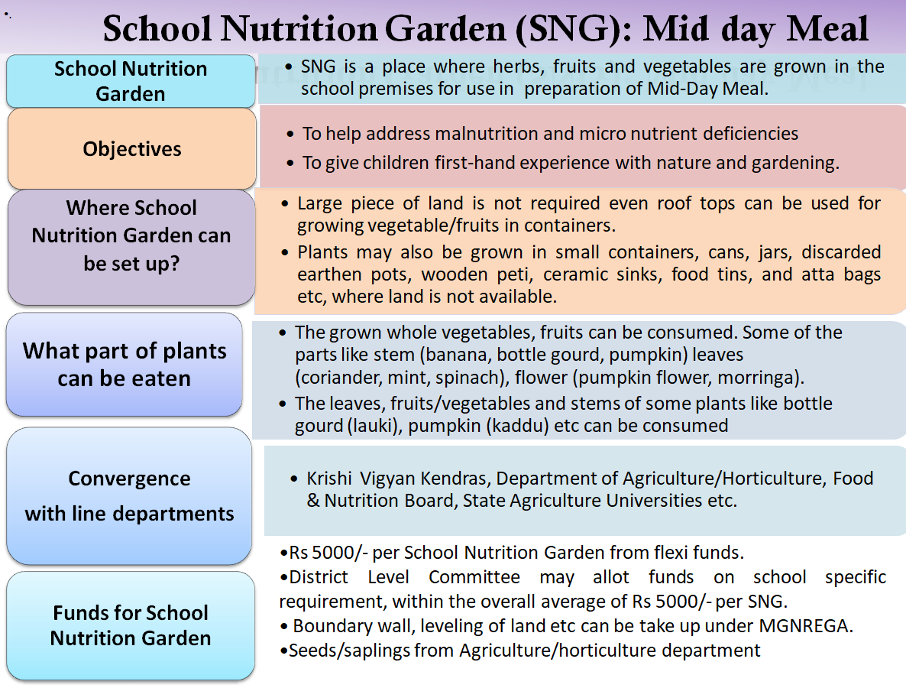
Focus of this year
Ministry of HRD, Govt. of India

Slide 12
Focus of this year
Ministry of HRD, Govt. of India

Slide 13
Focus of this year
Usage of Jails, Temples, Gurudwaras etc. for Mid Day Meal:
Temples, Gurudwaras, Jails etc. can be involved in Mid Day Meal Scheme.
Temples, Gurudwaras have greater reach among community, this can help in wider publicity for Mid Day Meal Scheme.
Temples, Gurudwaras can adopt some schools for providing meals.
Enhanced sense of ownership of the Mid Day Meal Scheme among the local community.
Uploading of videos, testimonials on Shagun web-portal:
Shagun web-portal is an innovation for repository of best practices which collates videos, testimonials, case studies and images of state-level innovations and success stories.
Accordingly, relevant videos, testimonials of the innovative activities being carried out by States/UTs related to Mid Day Meal may be shared with this department so that the same may be uploaded on Shagun (https://repository.ssashagun.nic.in) repository after necessary approvals.
Ministry of HRD, Govt. of India

Slide 14
Tithi Bhojan
Tithi Bhojan, is a community participation programme initiated by Gujarat.
Community provides full meal or additional items on special occasions, birthdays, marriages, anniversaries, days of national importance and other festivals etc.
Ministry of Human Resource Development has issued Guidelines on Tithi Bhojan on 26th October, 2018 to all the States and UTs.
Tithi Bhojan has been adopted by the States & UTs of Assam (Sampriti Bhojan), Andhra Pradesh, Punjab (Priti bhojan), Dadra & Nagar Haveli (Tithi Bhojan), Daman & Diu (Tithi Bhojan), Karnataka (Shalegagi Naavu Neevu), Madhya Pradesh, Maharastra (Sneh Bhojan), Chandigarh (Tithi Bhojan), Puducherry (Anna Dhanam), Haryana (Beti ka Janamdin) and Uttarakhand (Vishesh Bhojan).
Ministry of HRD, Govt. of India

Slide 15
Automated Monitoring System
1
AMS is used to monitor MDMS on real time basis.
2
Schools need to share the daily data on number of meals and reasons if meals are not served.
3
States/UTs are using various technologies (SMS/ IVRS/ Mobile App) for daily data collection.
Graphical dashboard: Reports are generated and displayed online
4
5
Drill down reports from State to school level are available
6
Daily email alerts are sent to States and UTs level regarding implementation of AMS.
Ministry of HRD, Govt. of India
15

Slide 16
Status of implementation of MIS & AMS
Ministry of HRD, Govt. of India

Slide 17
Amendment for involvement of Centralized Kitchens only in urban areas.
Amendment of the Gazette of India notification dated 18th April, 2019 stated that:
In the MDM Rules 2015, in rule 5 for sub-rule (2) the following sub-rule shall be substituted
“(2) Every school shall have the facility for cooking meal in hygienic manner. Schools in urban areas may use the facility of centralized kitchens for cooking meals wherever required in accordance with the guidelines issued by the Central Government and the meal shall be served to the children at respected school only”
Ministry of HRD, Govt. of India

Slide 18
Status of flow of funds from State to school
Name of State | Delay in release of fund from State to District / School
Jammu & Kashmir | 4 months
Ministry of HRD, Govt. of India

Slide 19
Focus of this year
Ministry of HRD, Govt. of India

Slide 20
Social Audit- Mid Day Meal Scheme
“Social audit" means the process in which people collectively monitor and evaluate the planning and implementation of a programme or scheme.
Importance:
Helps to ensure accountability and participation of all the stakeholders in the implementation of Mid Day Meal Scheme
It creates a sense of ownership and increases the reach of the scheme up to the beneficiaries.
Social audit enables the State Governments to identify and resolve gaps in the implementation of Mid Day meal Scheme.
Status :
Social Audit carried out in Uttarakhand and Tripura in 2018-19.
Social intervention for Community Participation under MDMS
Ministry of HRD, Govt. of India

Slide 21
Recommendations
S. No | State | PAB Approval for FY 2018-19 (Rs. in Lakhs) | Proposal for FY 2019-20 (Rs. in Lakhs) | Recommendations for FY - 2019-20 (Rs. in Lakhs)
1 | Jammu & Kashmir | 11468.65 | 16359.01 | 10656.65
Ministry of HRD, Govt. of India

Slide 22
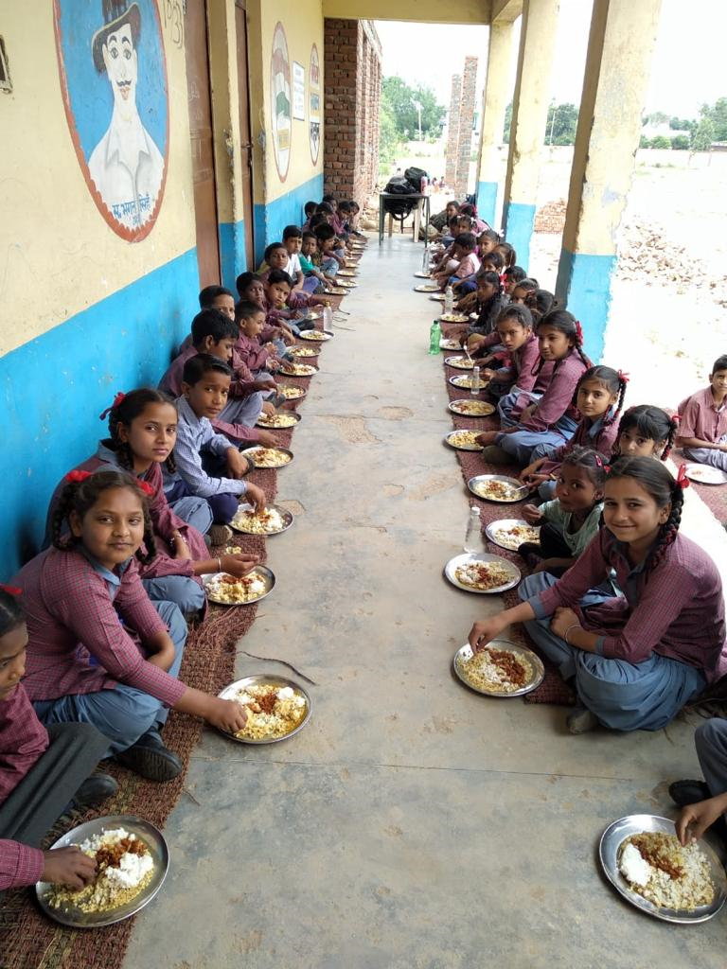
A meal to a Child is an offering to the Divinity.
Thank You
Ministry of HRD, Govt. of India

Slide 23
Jammu & Kashmir : Proposals and Recommendations
Sl. No. | Component | PAB Approval 2018-19 | Proposal for 2019-20 | Recommendation 2019-20
1 | Children (Primary) | 518694 | 611994 | 445466
2 | Children (Upper Primary) | 258304 | 315757 | 218053
3 | Children (NCLP) | Nil | Nil | Nil
4.1 | Working Days (Primary) | 220 | 220 | 220
4.2 | Working Days (Upper Primary) | 220 | 220 | 220
4.3 | Working Days (NCLP) | Nil | Nil | Nil
5 | Cook cum Helpers | 17772 | 17772 | 17772
6 | Kitchen-cum-Stores | 15496 | 15496 | 15496
7 | Kitchen-cum-stores (Repair) | Nil | Nil | Nil
8 | Kitchen Devices (New) | Nil | 278 | Nil
9 | Kitchen Devices (Rep) | Nil | 22341 | Nil
10 | School Nutrition Gardens | Nil | Nil | Nil
11 | Supplementary Nutrition (no. of children) | Nil | Nil | Nil
Central Assistance (Rs in Lakh) |  | 11468.65 | 16359.01 | 10656.65
Back to Main Page
Ministry of HRD, Govt. of India

